Slide 1
Probability Mass Functions Distributions Probability Density Functions

Slide 2


Slide 3
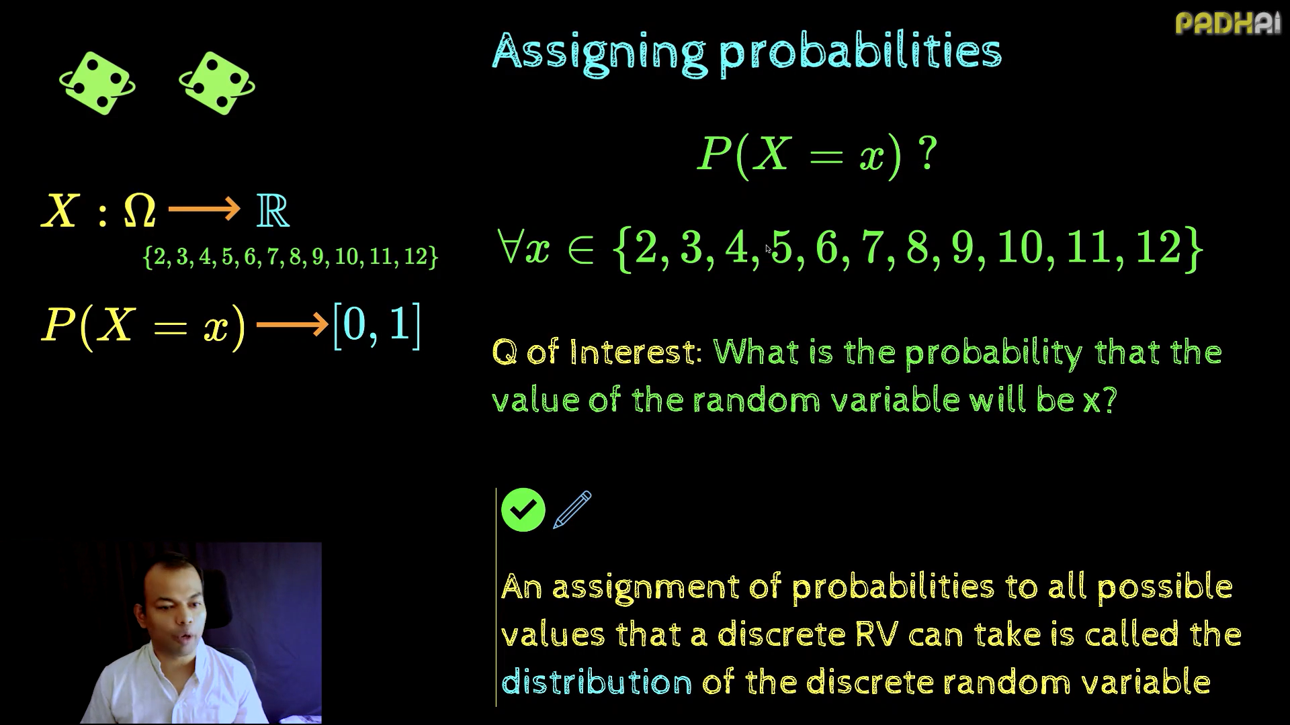

Slide 4
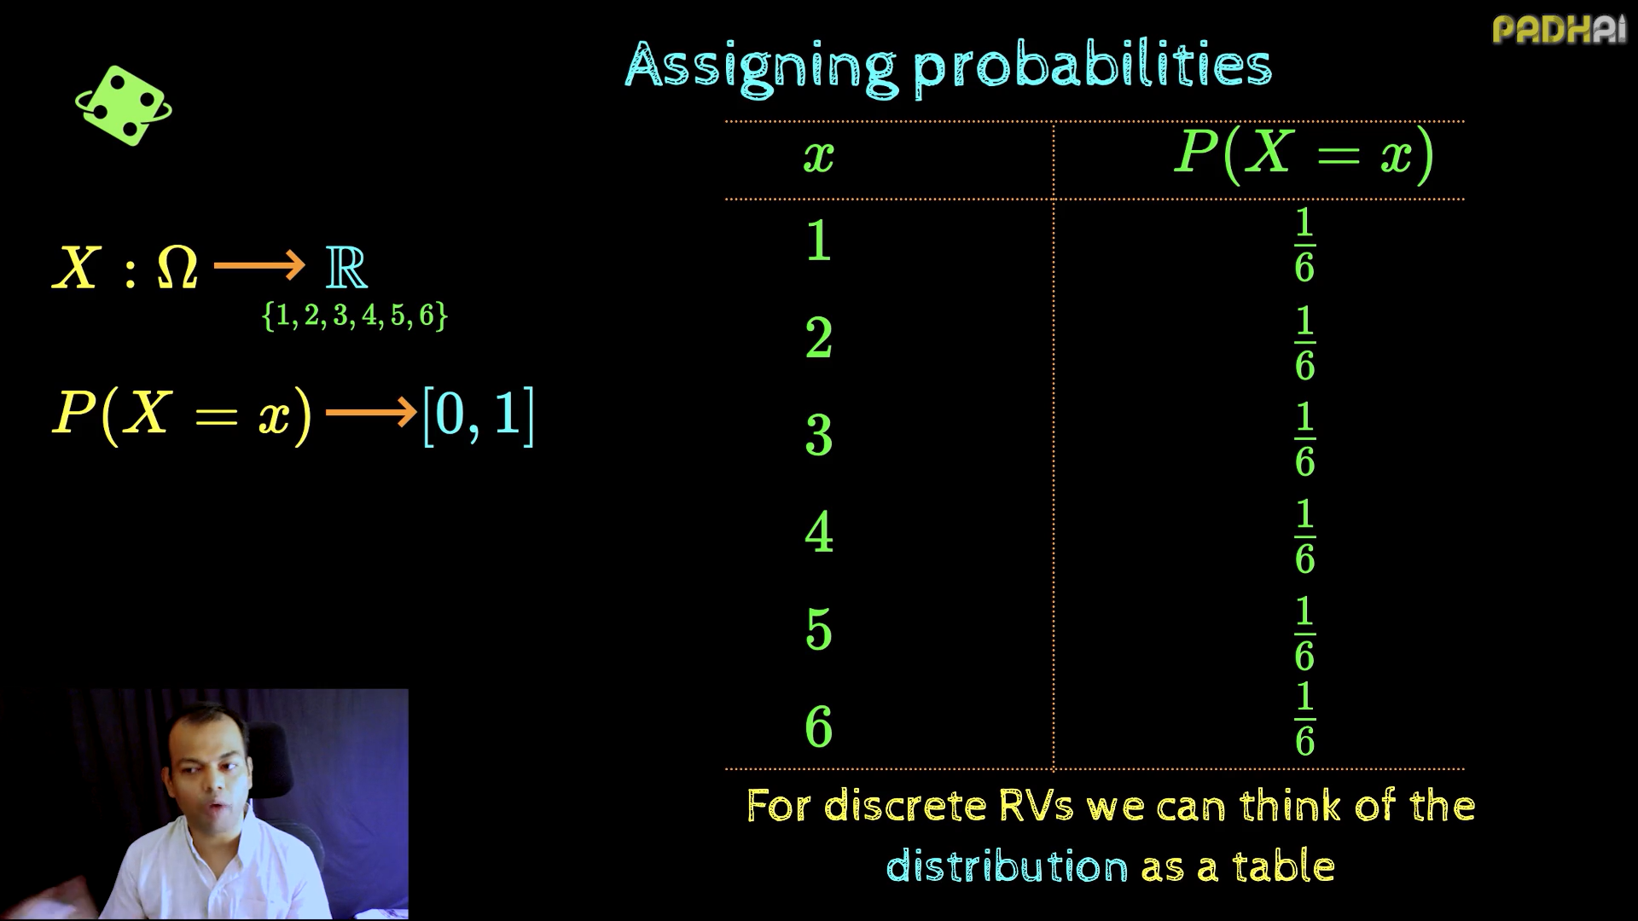

Slide 5
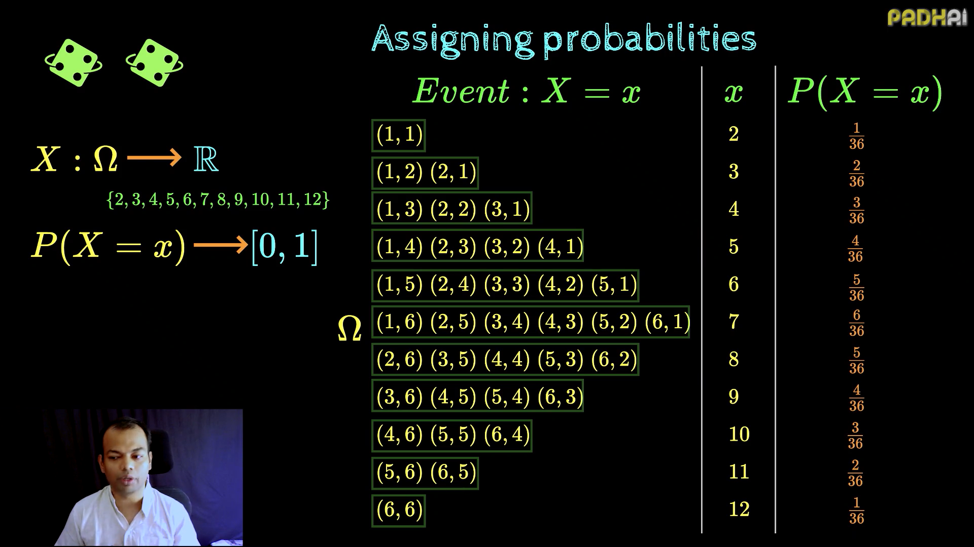

Slide 6
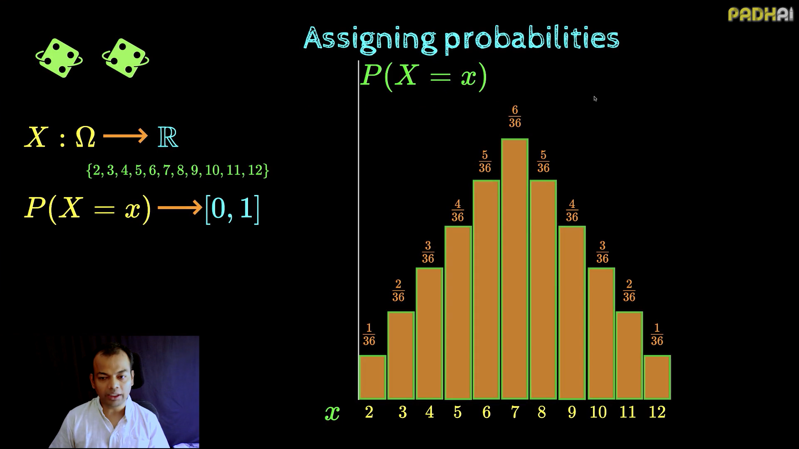

Slide 7
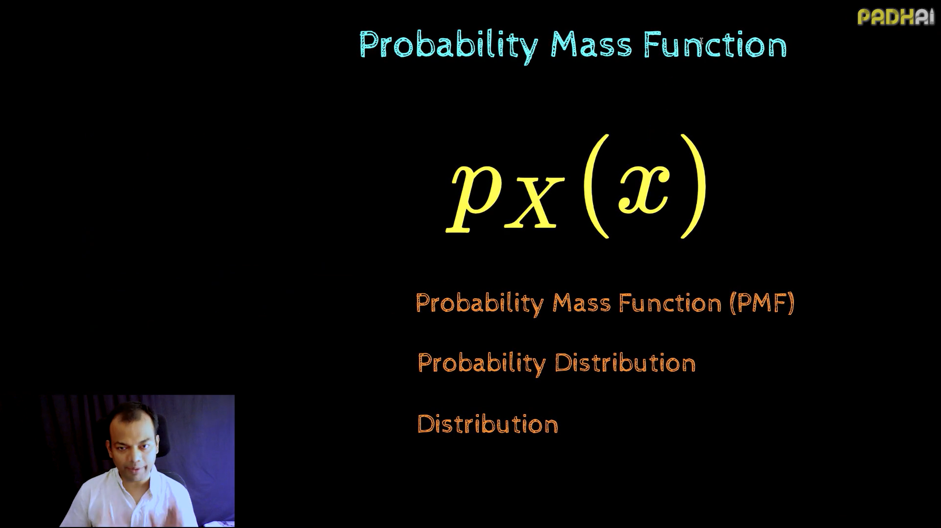

Slide 8
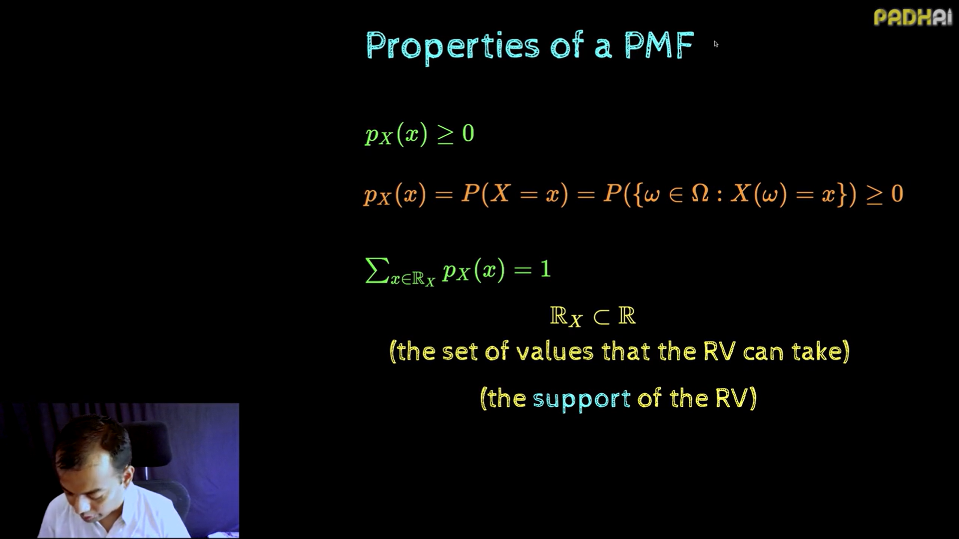

Slide 9
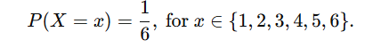
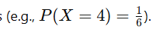
Summary
What is Probability Mass Function (PMF)?
Definition: The PMF is a function that gives the probability of a discrete random variable taking on specific values.
Key Characteristics:
Applies to discrete random variables.
The probabilities must sum to 1.
Example: Rolling a die, flipping a coin, number of cars passing a toll booth.
Example: Rolling a Die
Random variable X: The outcome of a die roll.
Possible values: 1,2,3,4,5,6
PMF:
Utility of PMF: Helps calculate probabilities for specific outcomes :
Real-World Scenarios for PMF:
Customer Orders: Number of items ordered by a customer in a single transaction.
Quality Control: Number of defective products in a batch.
Elections: Number of votes received by a candidate in a small polling station.

Slide 10
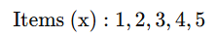
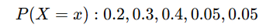
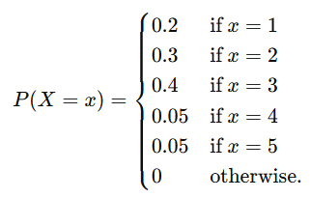
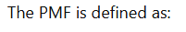
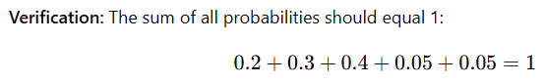
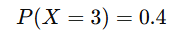
Example PMF:
An e-commerce website records the number of items customers buy per transaction. Question: a) Define the PMF for the number of items purchased. b) What is the probability that a customer buys 3 items?
a: Assume the random variable X represents the number of items purchased in a transaction. The data collected shows:
b: The probability that a customer buys 3 items

Slide 11
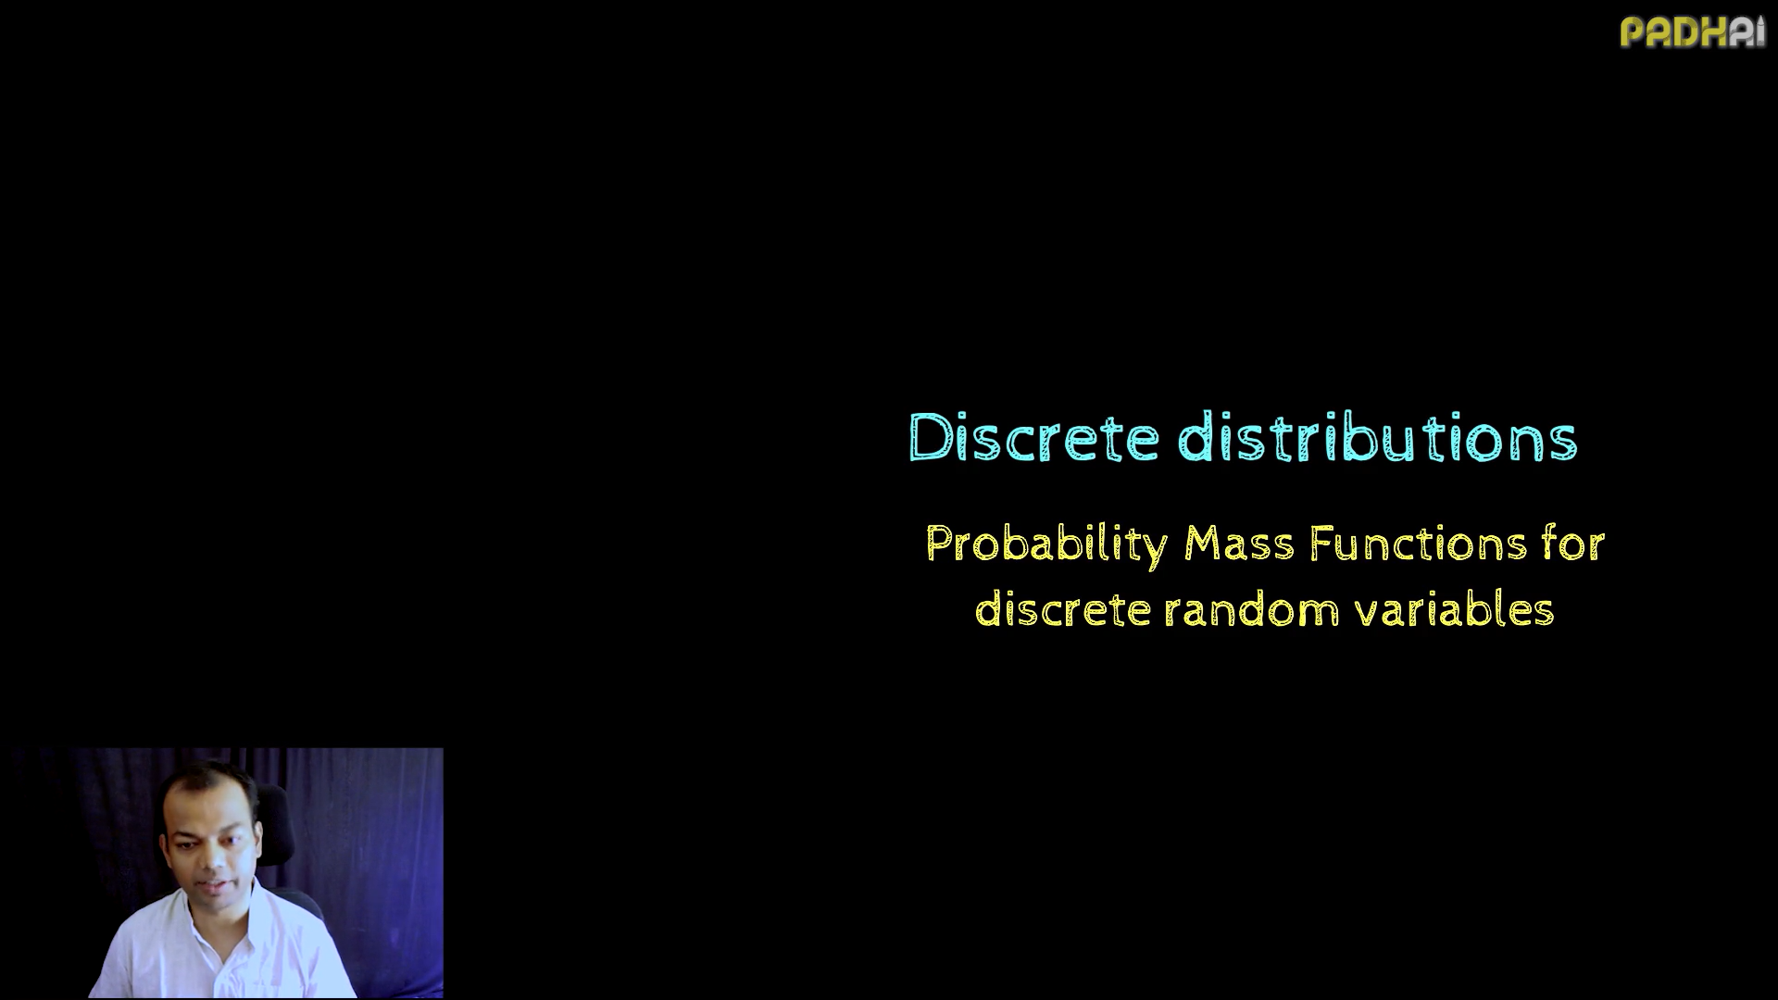

Slide 12
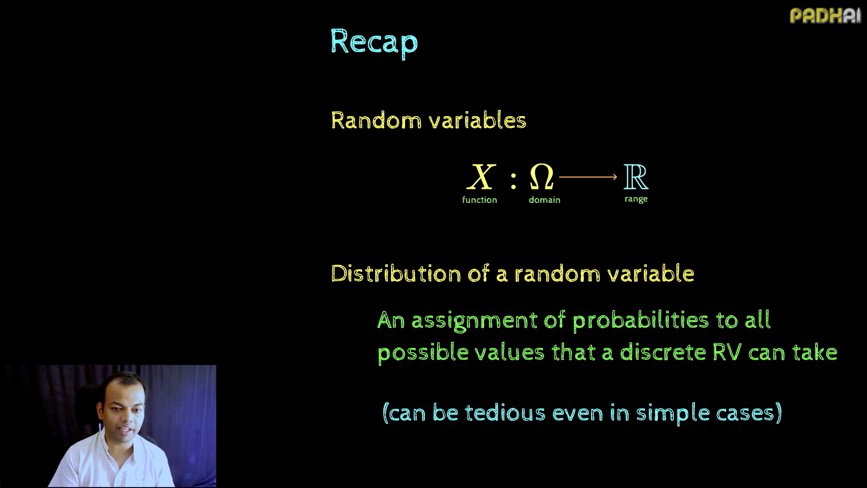

Slide 13
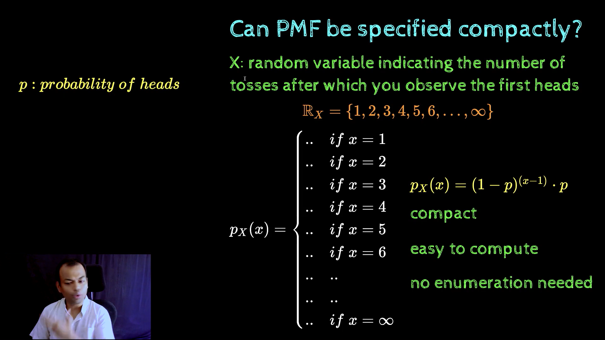

Slide 14
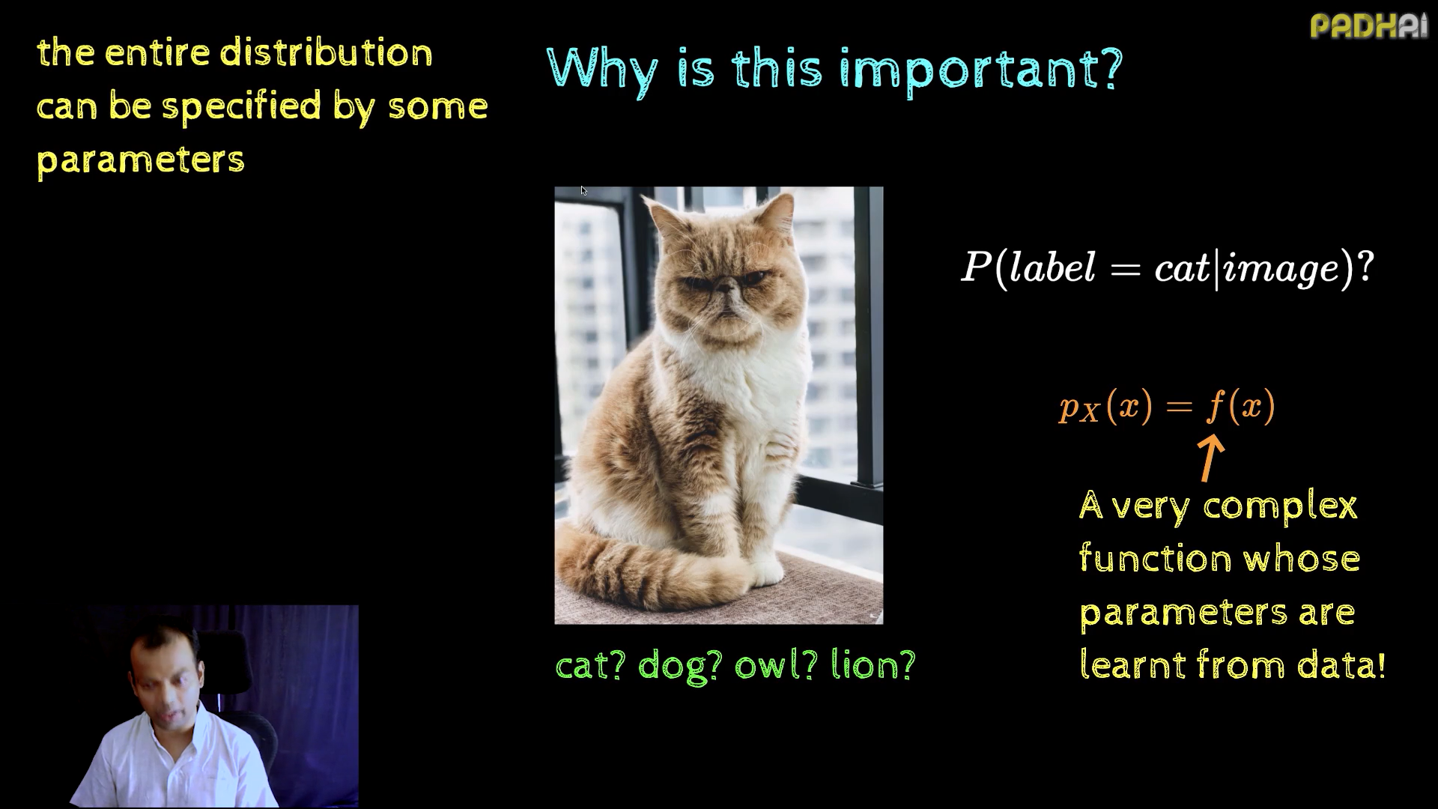

Slide 15
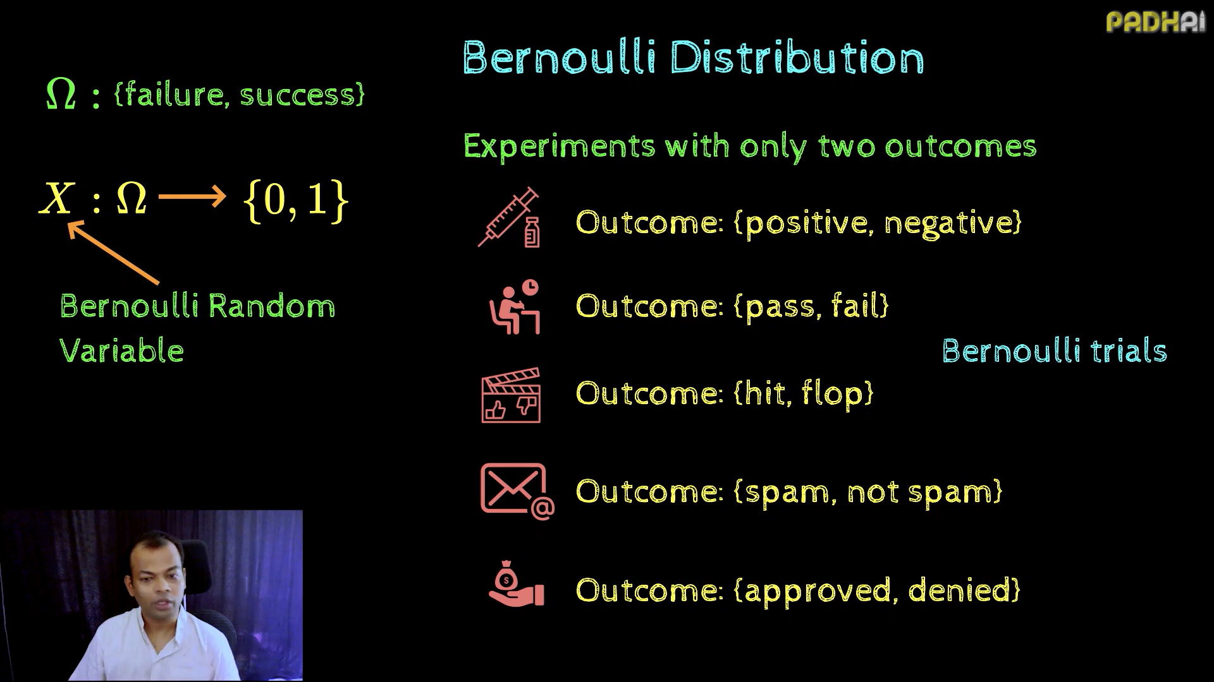

Slide 16
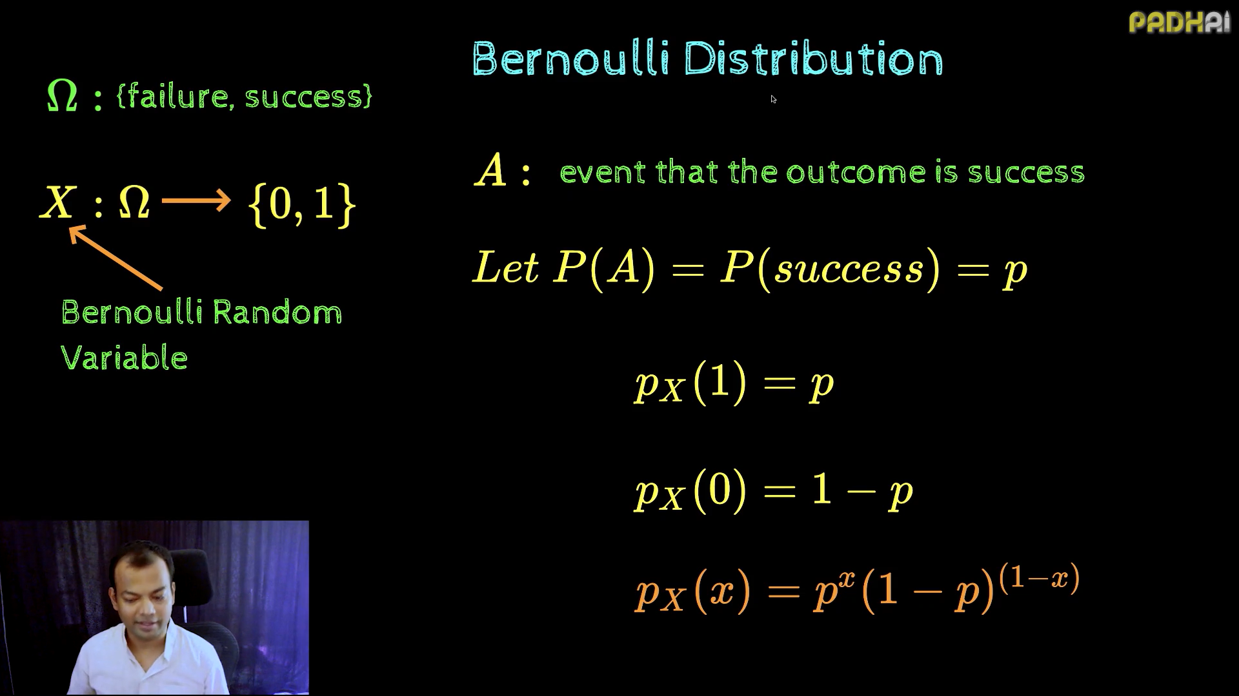

Slide 17
Give examples from real world where Bernoulli distributions can be applied?
Online Advertising
Scenario: Whether a user clicks on an online ad or not.
Outcomes:
Success: The user clicks on the ad.
Failure: The user does not click on the ad.
Use Case: Understanding click-through rates for digital marketing campaigns.
Voting Behavior
Scenario: Determining whether an individual will vote for a candidate.
Outcomes:
Success: The individual votes for the candidate.
Failure: The individual does not vote for the candidate.
Use Case: Modeling binary voting behavior in opinion polls.
Medical Trials
Scenario: Testing if a new drug is effective.
Outcomes:
Success: The patient responds positively to the drug.
Failure: The patient does not respond positively.
Use Case: Modelling individual trial results for hypothesis testing.
Quality Control in Manufacturing
Scenario: Inspecting whether a product meets quality standards.
Outcomes:
Success: The product passes the quality check.
Failure: The product fails the quality check.
Use Case: Estimating defect rates in production
Subscription Renewals
Scenario: Whether a user renews their subscription to a service.
Outcomes:
Success: The user renews.
Failure: The user does not renew.
Use Case: Calculating churn rates for subscription-based businesses.
Sports
Scenario: Whether a cricket player hits a boundary on a given ball.
Outcomes:
Success: The player hits a boundary.
Failure: The player does not hit a boundary.
Use Case: Analyzing performance metrics of players.

Slide 18
Summary
Bernoulli distributions form the foundation of many statistical concepts and are essential components in data science. Their simple binary nature, combined with wide-ranging applications in machine learning, hypothesis testing, and simulation, makes them a key framework for analyzing and modeling binary outcomes.
Here are the takeaways:
Bernoulli distributions model single trials with two possible outcomes.
The probability of success p is the key parameter that defines the distribution.
They have many applications in binary classification, hypothesis testing, and simulations.
Powerful, alternatives like binomial and geometric distributions may be more appropriate in certain scenarios.

Slide 19
FAQs
What is a Bernoulli distribution?
A Bernoulli distribution is a discrete probability distribution for a random variable that has only two possible outcomes: success (usually denoted as 1) or failure (usually denoted as 0). It is characterized by a single parameter p, which represents the probability of success.
Can Bernoulli distributions be used for hypothesis testing?
Yes, Bernoulli distributions are commonly used in hypothesis testing, especially for scenarios involving proportions or success rates. They're particularly useful in A/B testing, where you're comparing the success rates of two different strategies or treatments.
How can I estimate the parameter p of a Bernoulli distribution from data?
The most common method to estimate p is the maximum likelihood estimation (MLE). For a Bernoulli distribution, the MLE of p is simply the proportion of successes in your sample. For example, if you observe 7 successes out of 10 trials, your estimate of p would be 0.7.
What's the difference between a Bernoulli and a Binomial distribution?
A Bernoulli distribution models a single trial with two possible outcomes, while a Binomial distribution models the number of successes in a fixed number of independent Bernoulli trials. You can think of a Binomial distribution as a sum of multiple Bernoulli distributions.

Slide 20
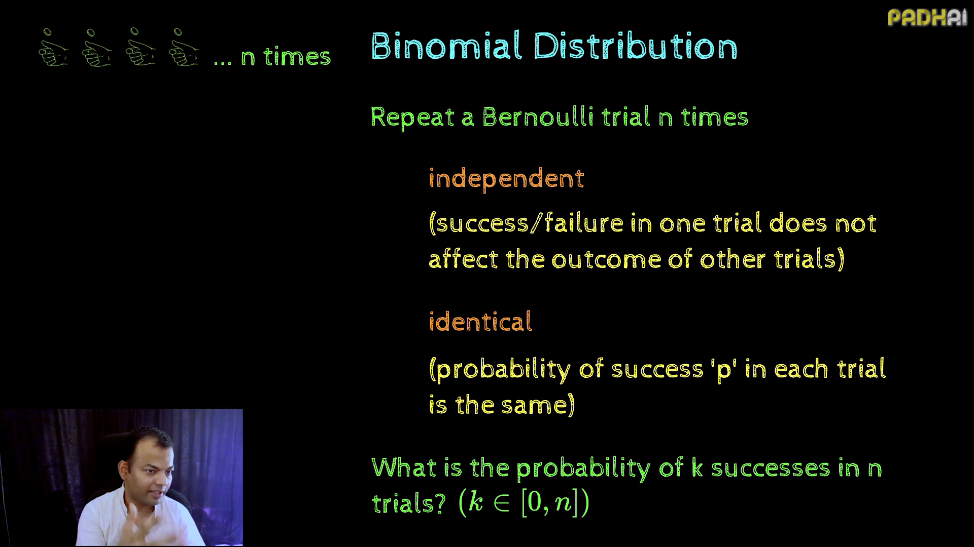

Slide 21
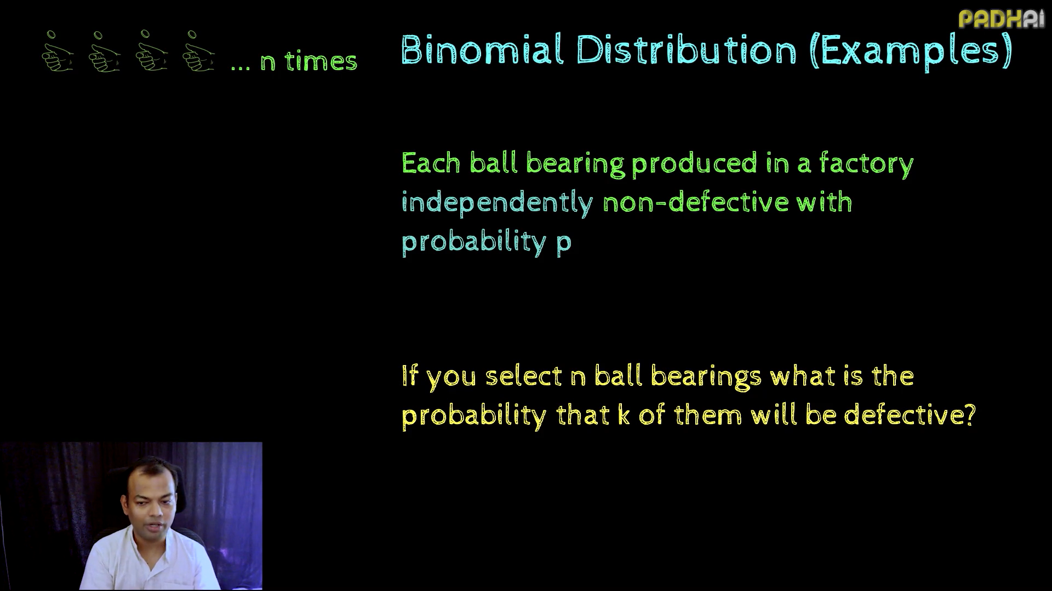

Slide 22
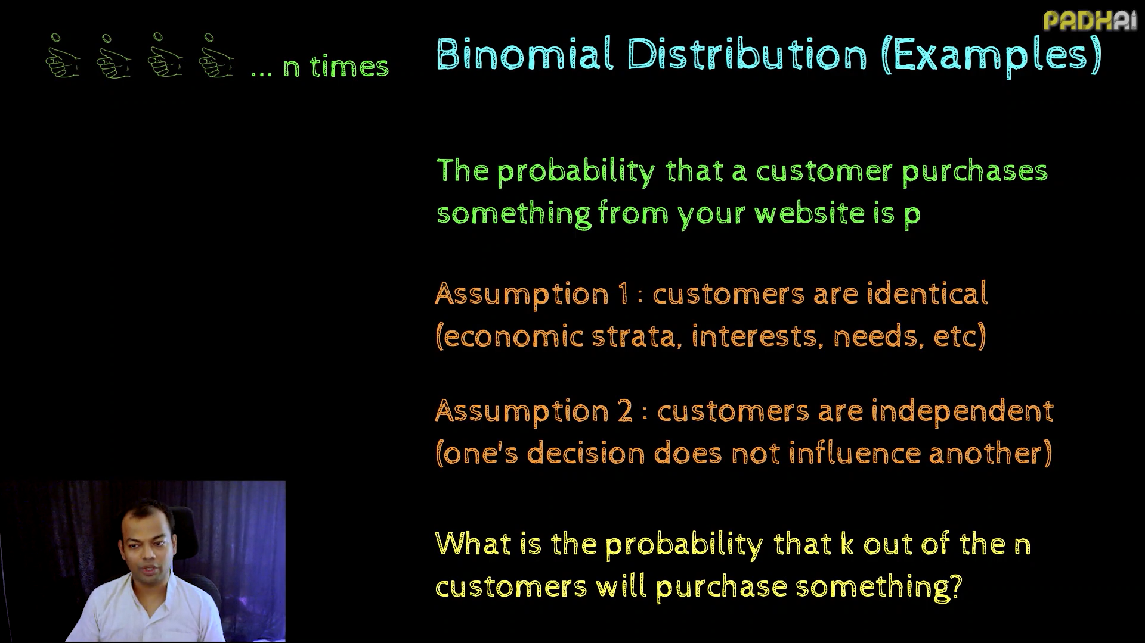

Slide 23
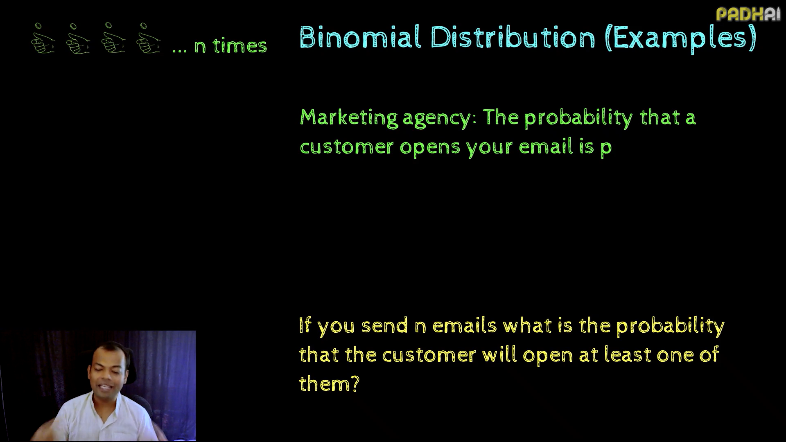

Slide 24
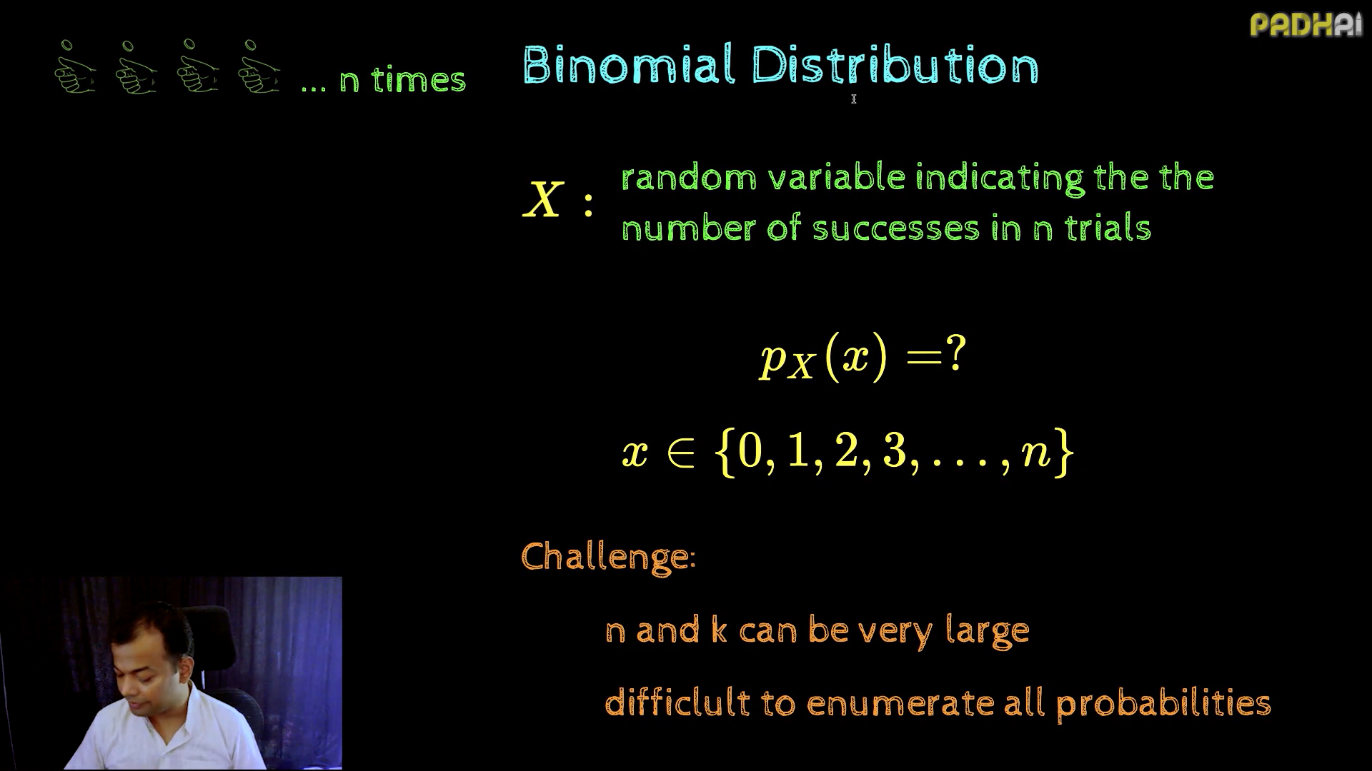

Slide 25
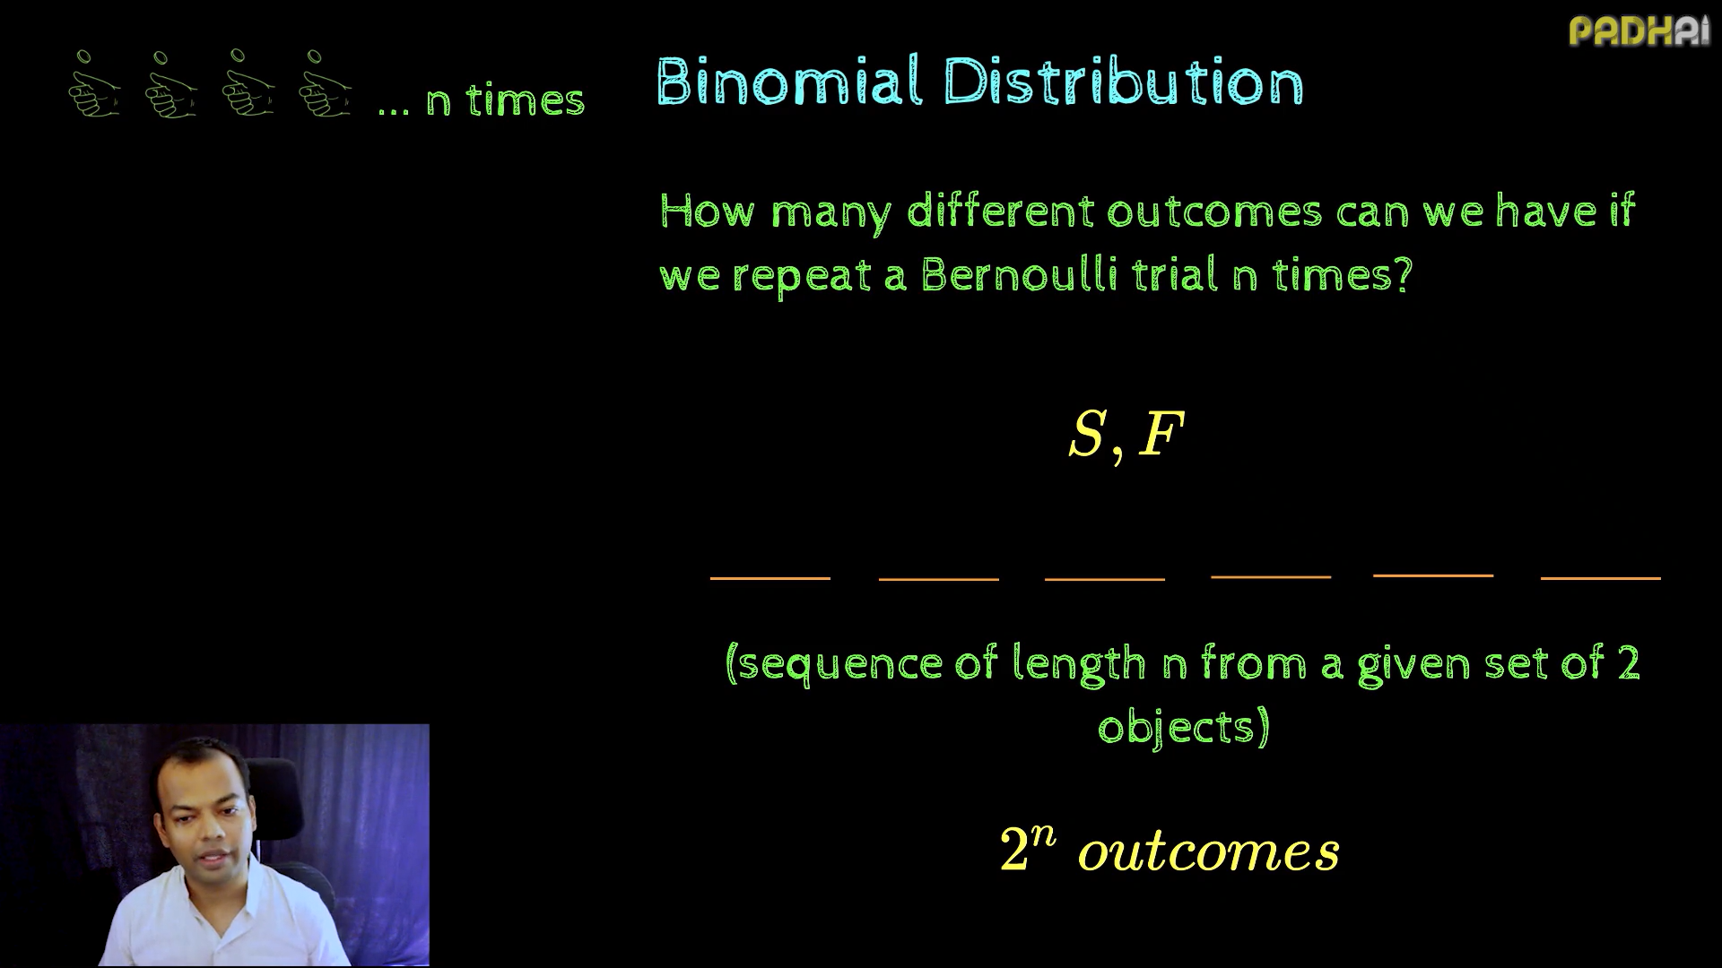

Slide 26
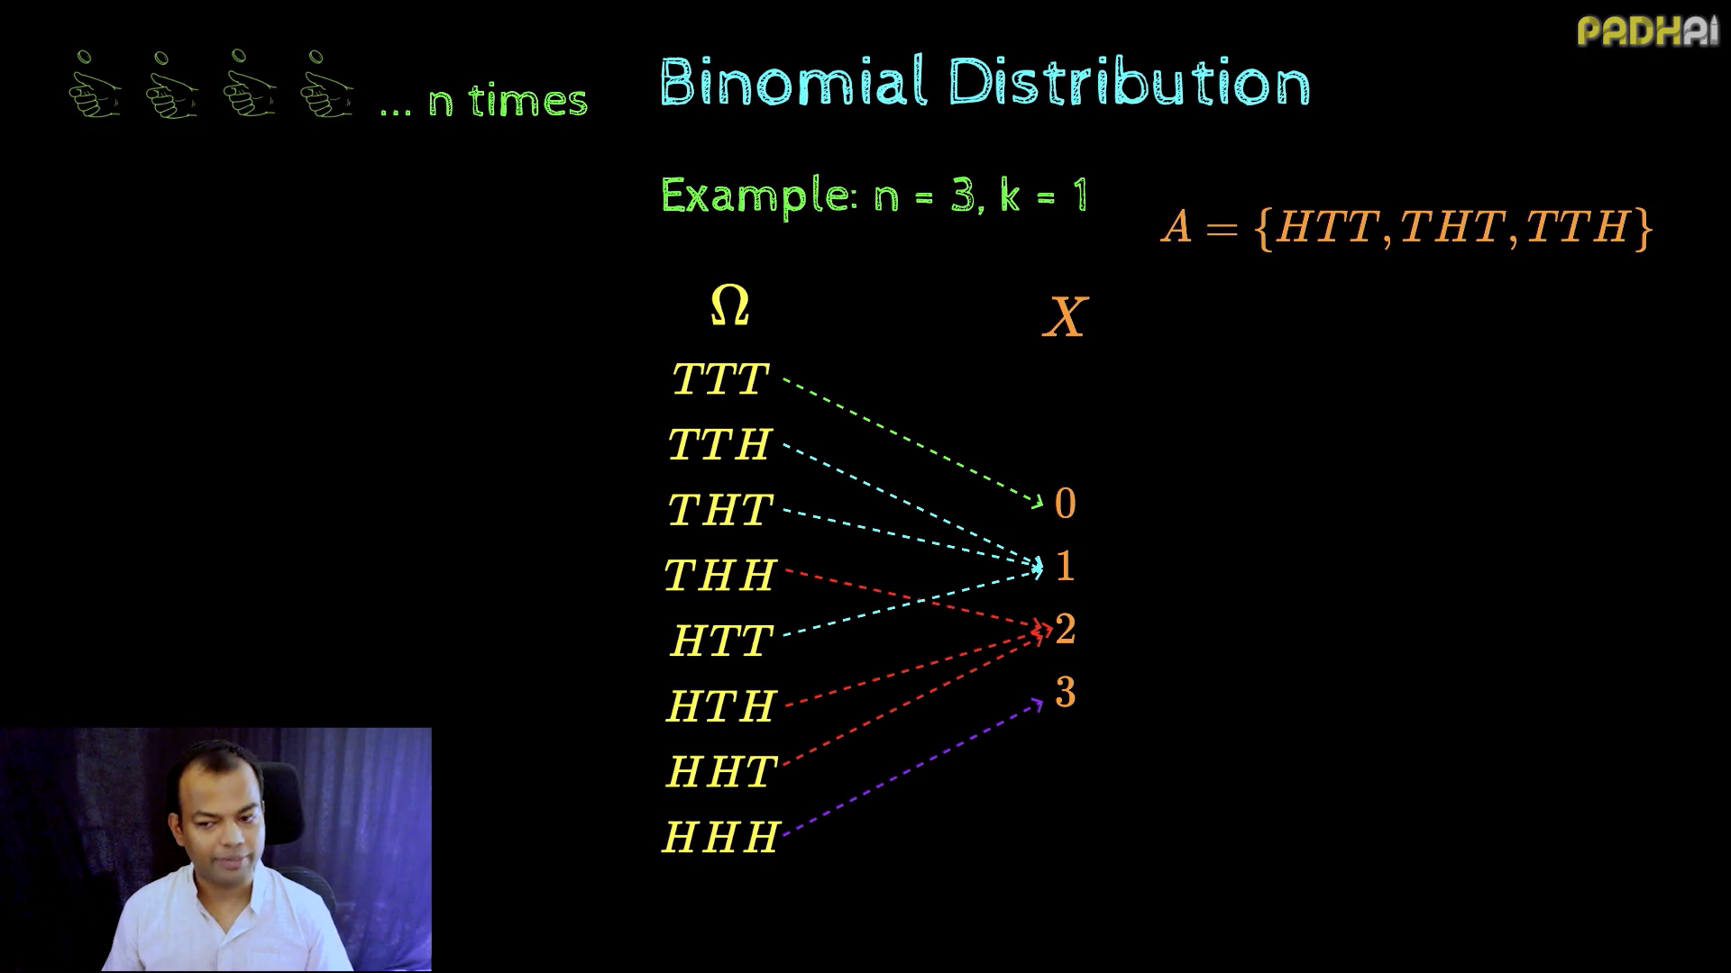

Slide 27
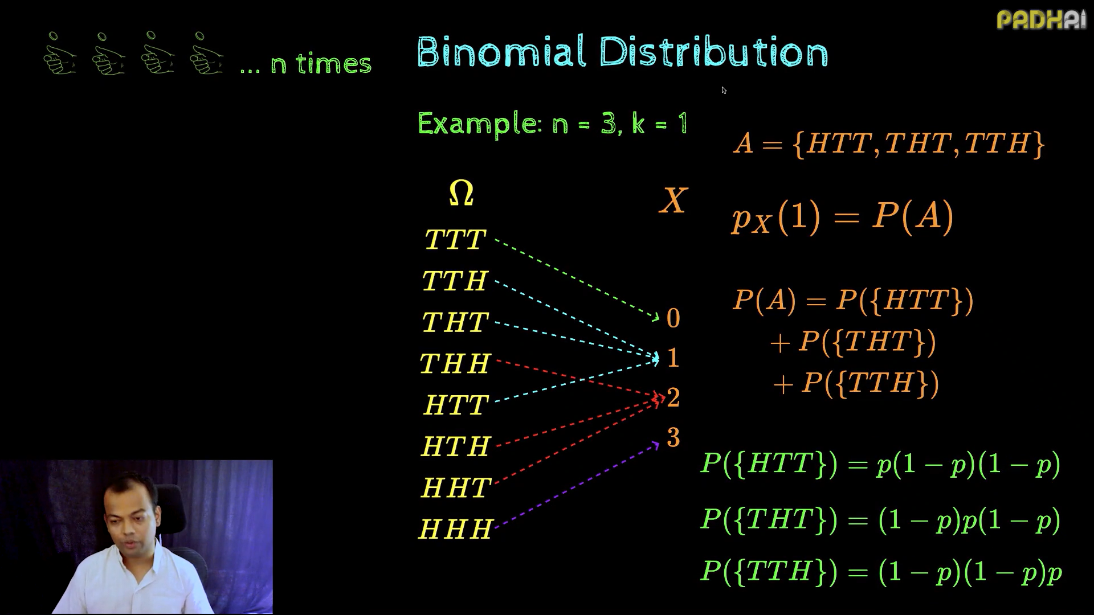

Slide 28
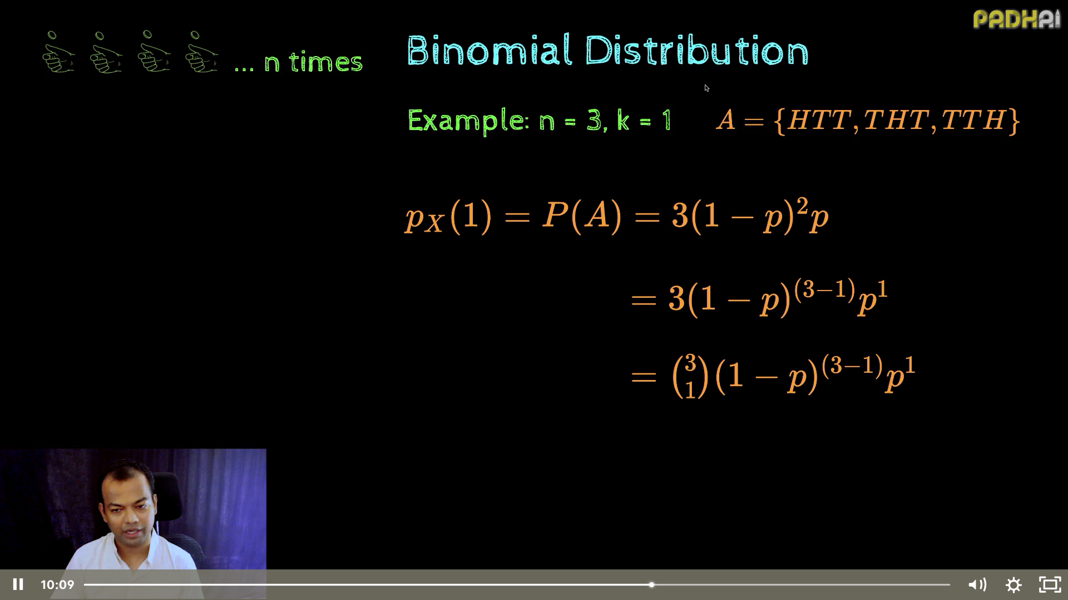

Slide 29
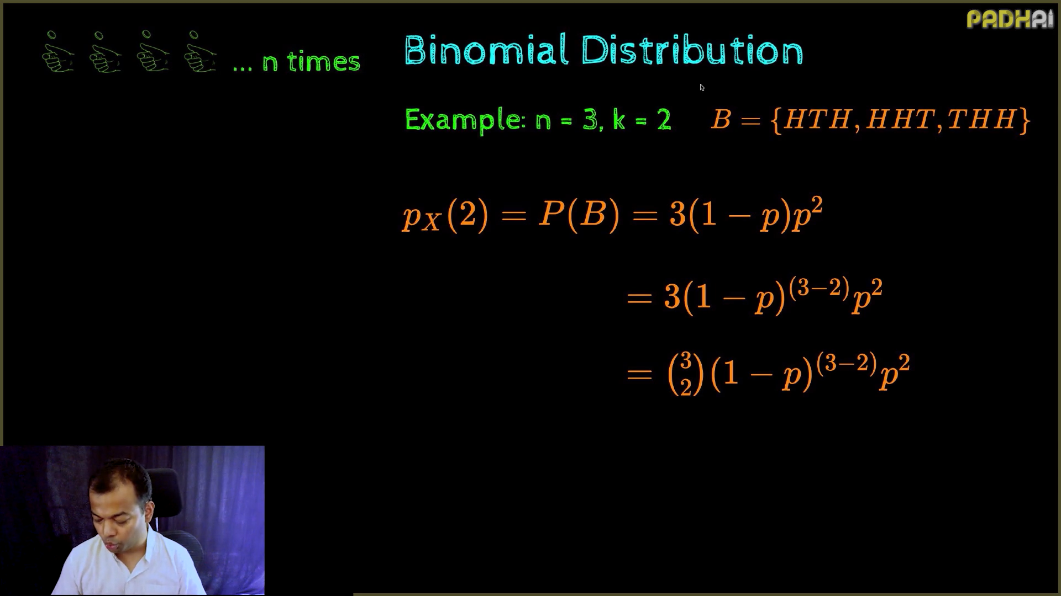

Slide 30
Bernoulli Vs Binomial
Online Advertising
Scenario: Whether a user clicks on an online ad or not.
Outcomes:
Success: The user clicks on the ad.
Failure: The user does not click on the ad.
Use Case: Understanding click-through rates for digital marketing campaigns.
Online Advertising Campaigns
Scenario: Out of 1,000 users who see an ad, how many will click on it?
Key Features:
Each user sees the ad (independent trials).
Success: The user clicks on the ad.
Failure: The user does not click on the ad.
Use Case: Estimating the click-through rate for a campaign.

Slide 31
Bernoulli Vs Binomial
Medical Trials
Scenario: Testing if a new drug is effective.
Outcomes:
Success: The patient responds positively to the drug.
Failure: The patient does not respond positively.
Use Case: Modelling individual trial results for hypothesis testing.
Scenario: In a clinical trial of 50 patients, how many respond positively to a new drug?
Key Features:
Each patients response is independent.
Success: The patient responds positively.
Failure: The patient does not respond.
Use Case: Estimating the effectiveness of the drug.

Slide 32
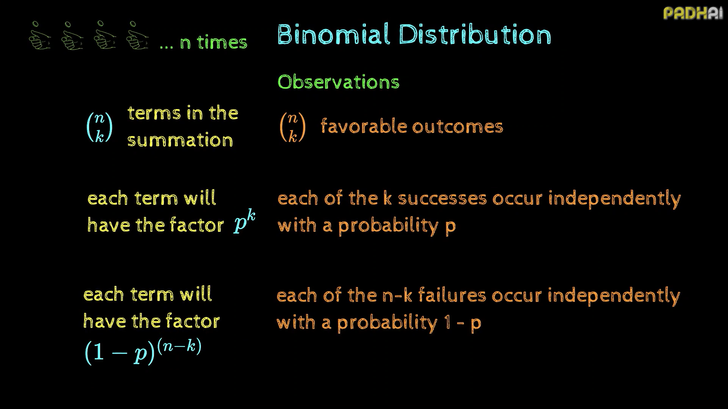

Slide 33
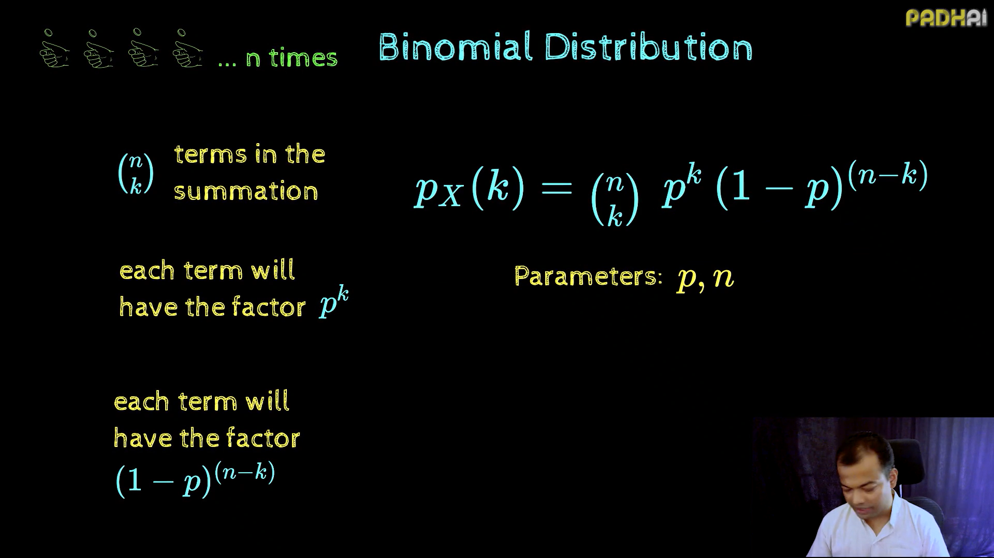

Slide 34
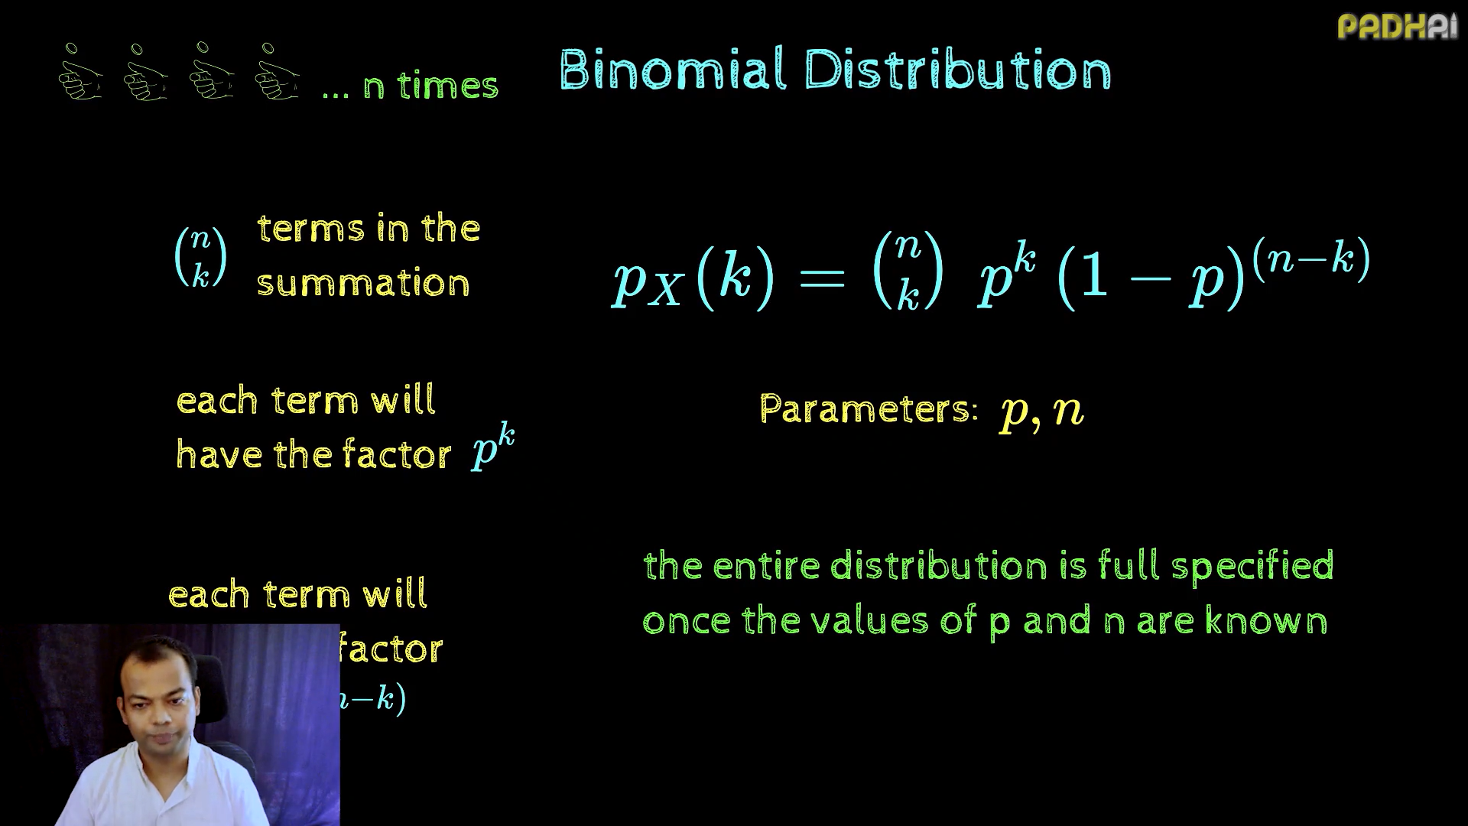

Slide 35
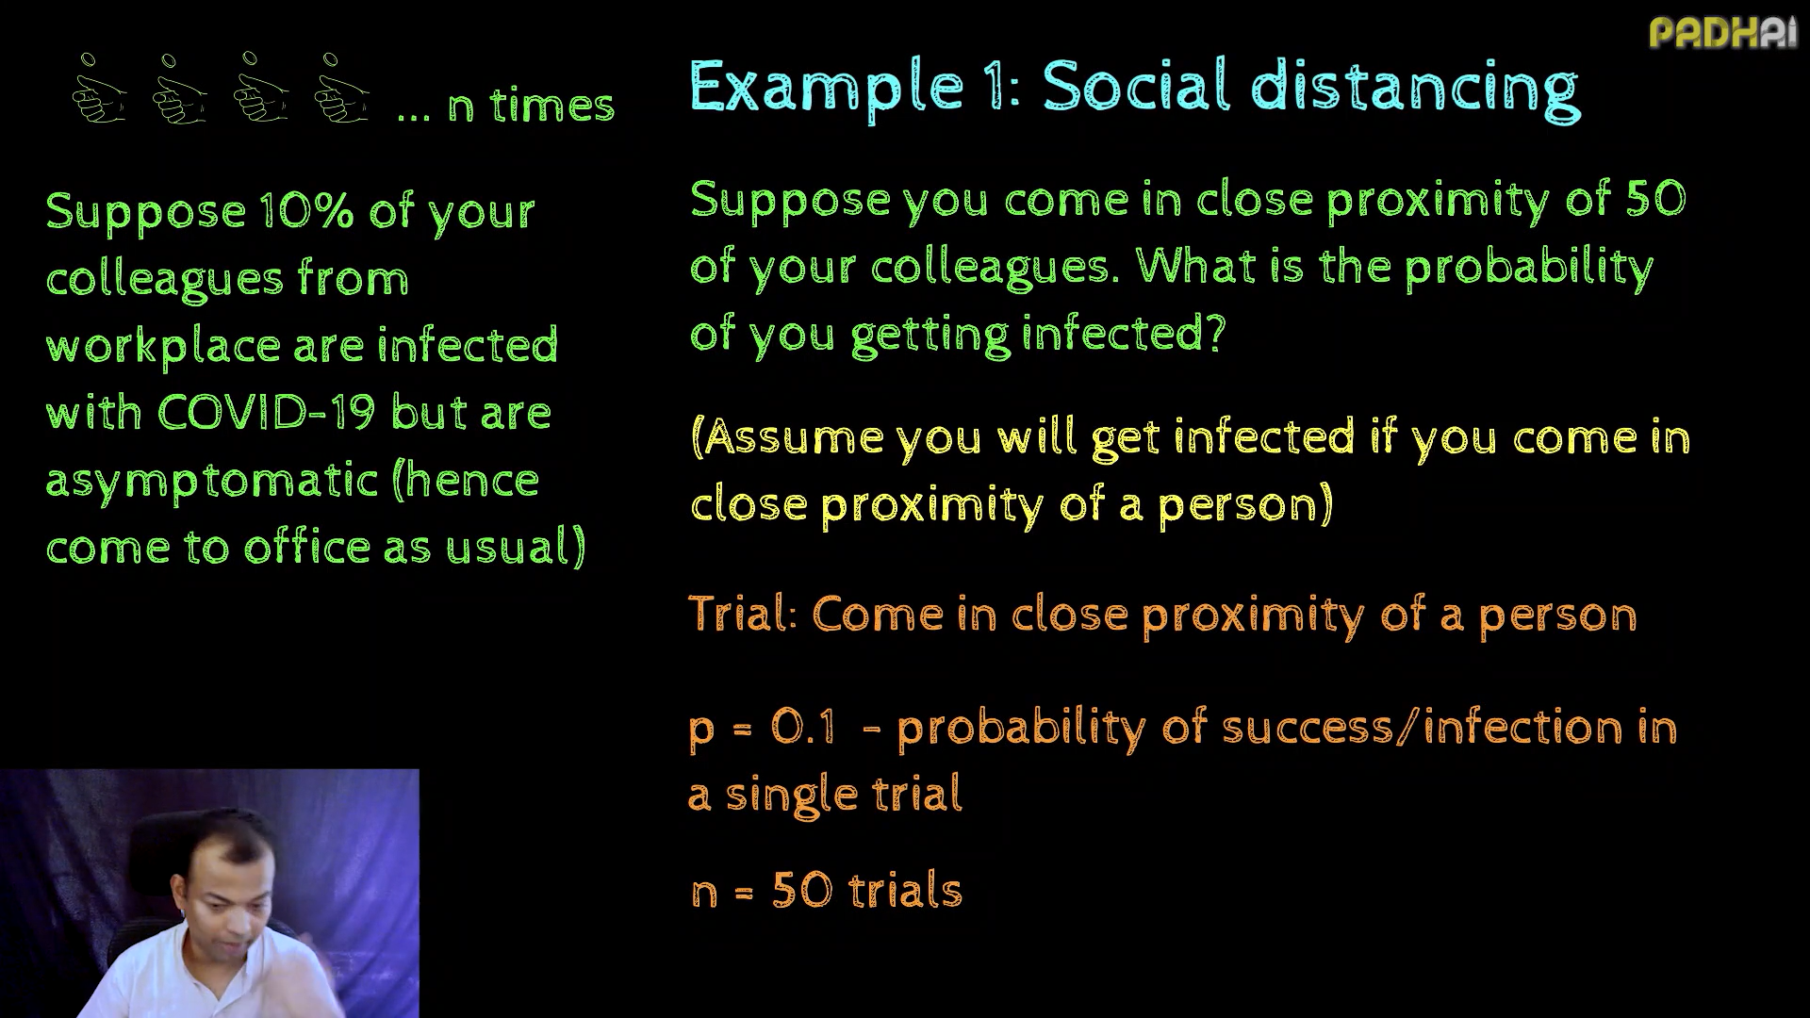

Slide 36
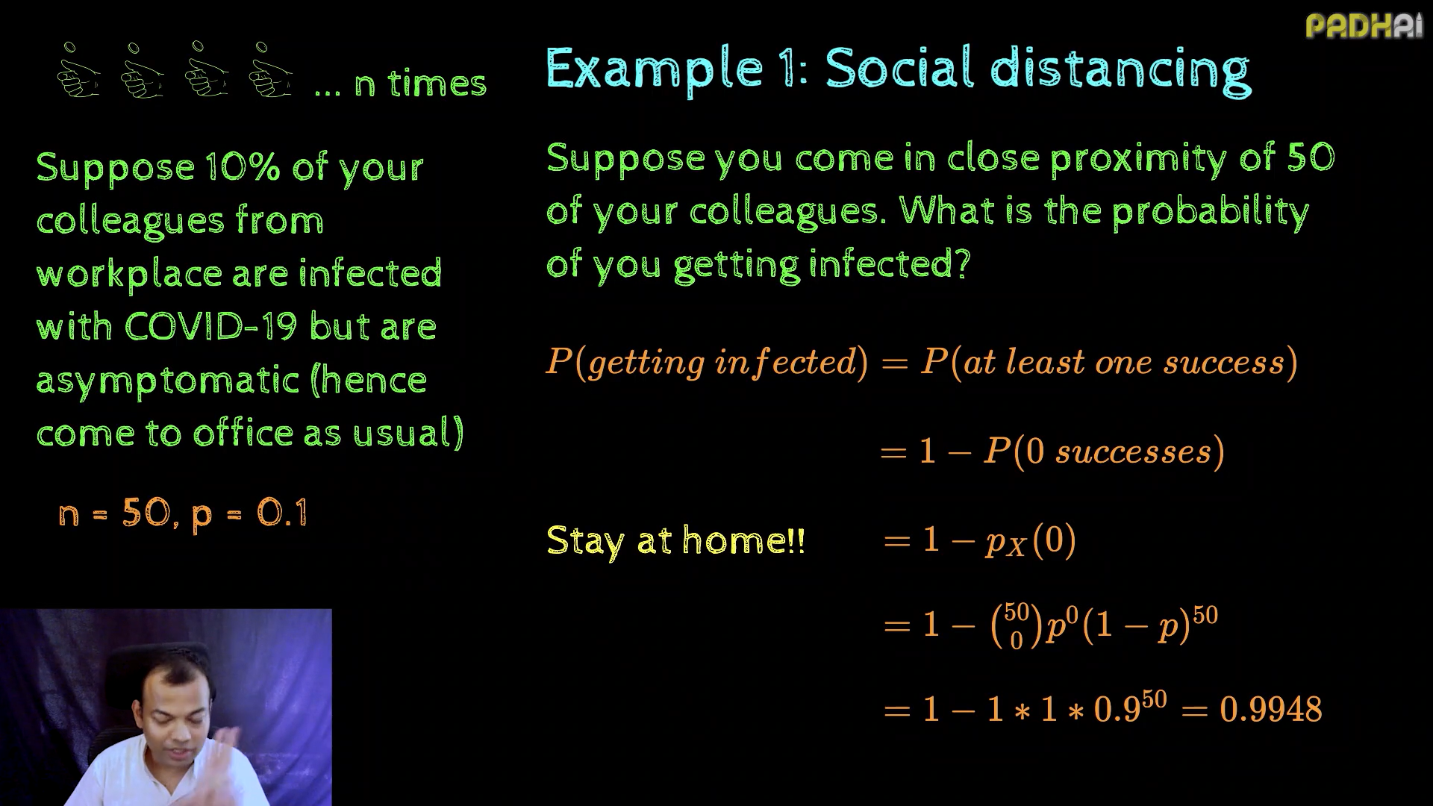

Slide 37
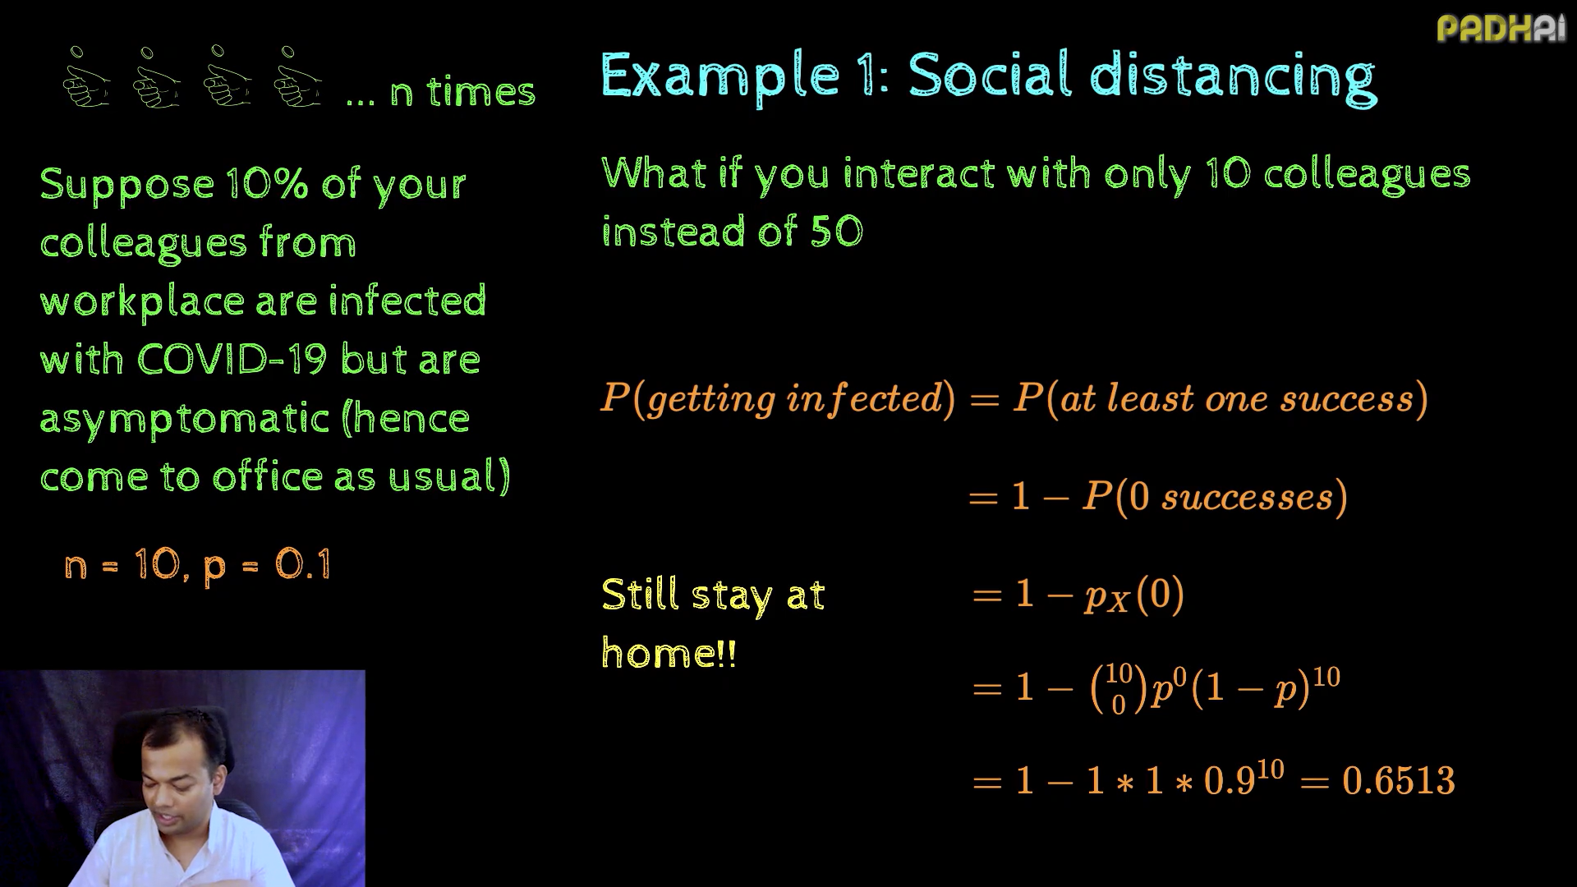

Slide 38
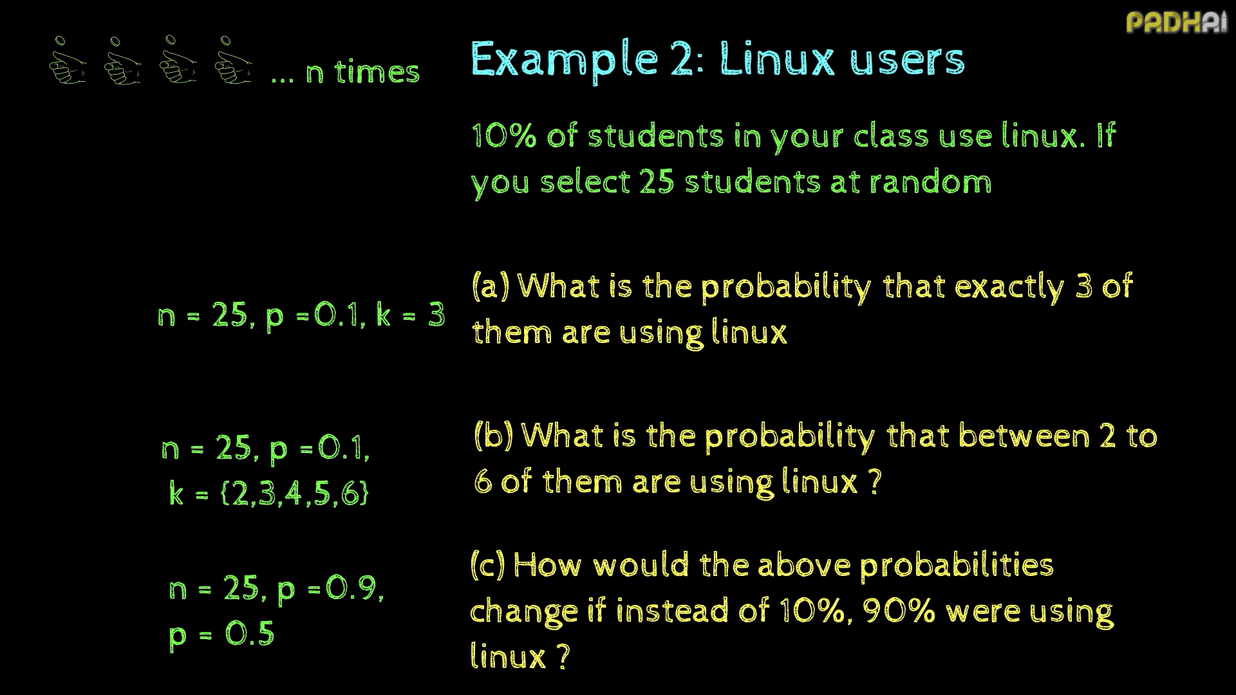

Slide 39
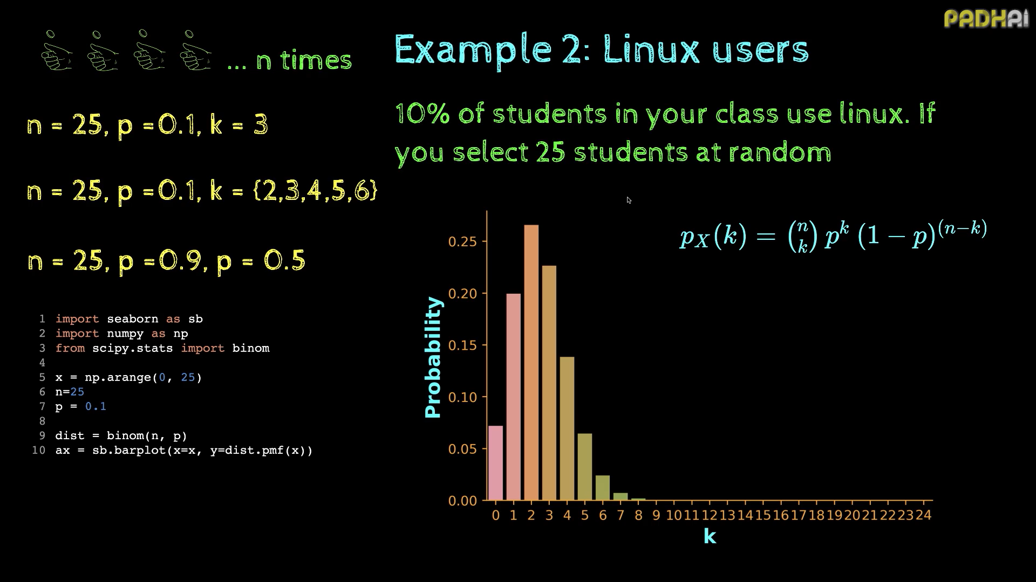

Slide 40
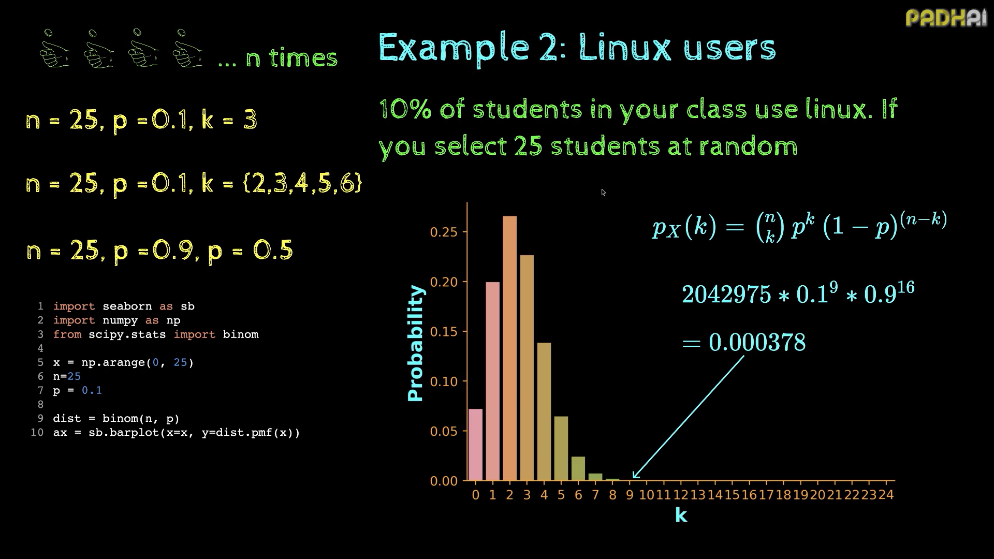

Slide 41
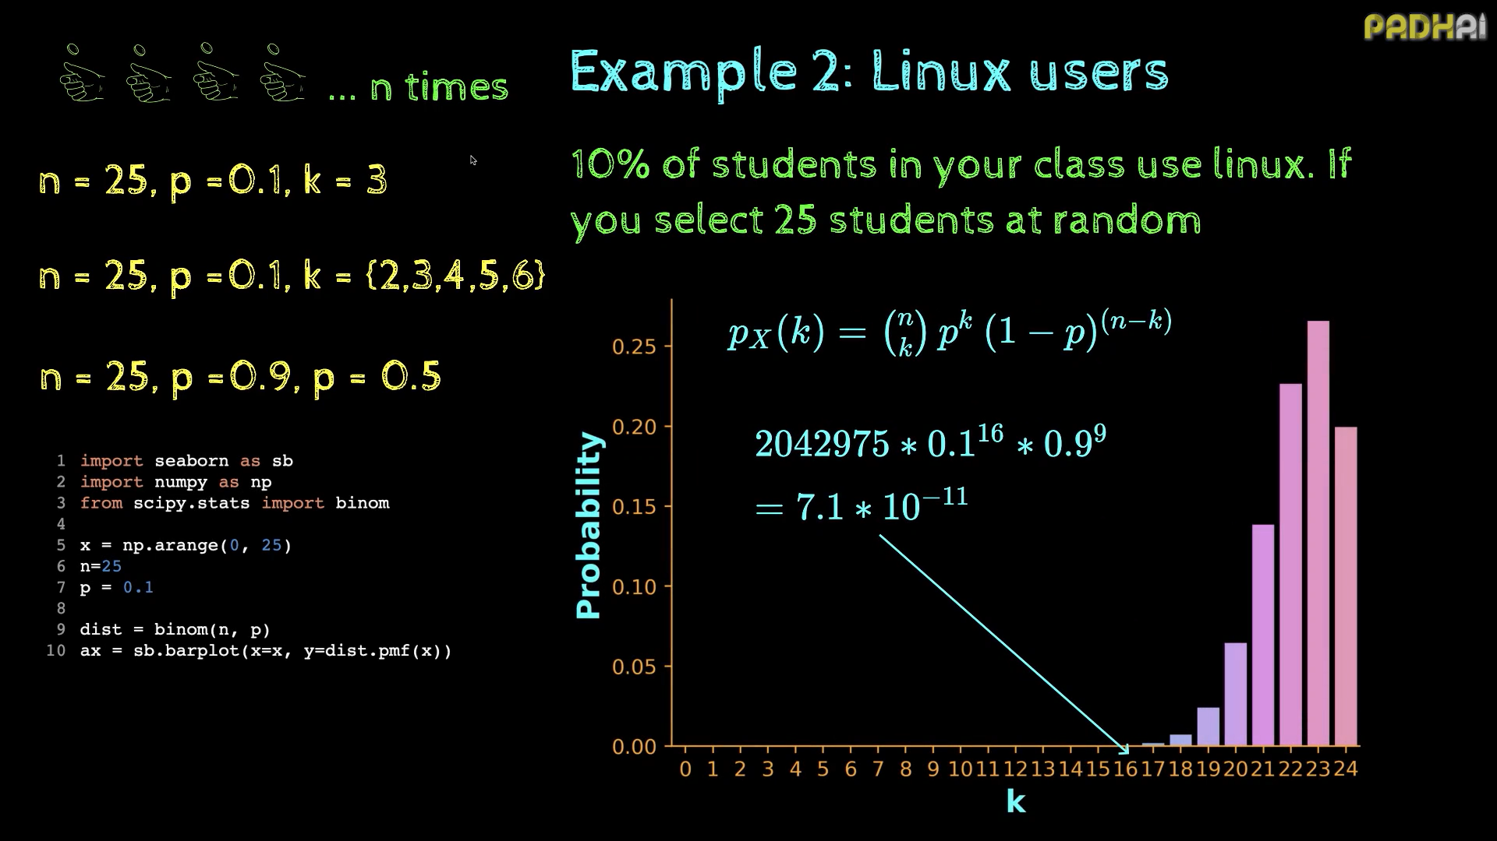

Slide 42
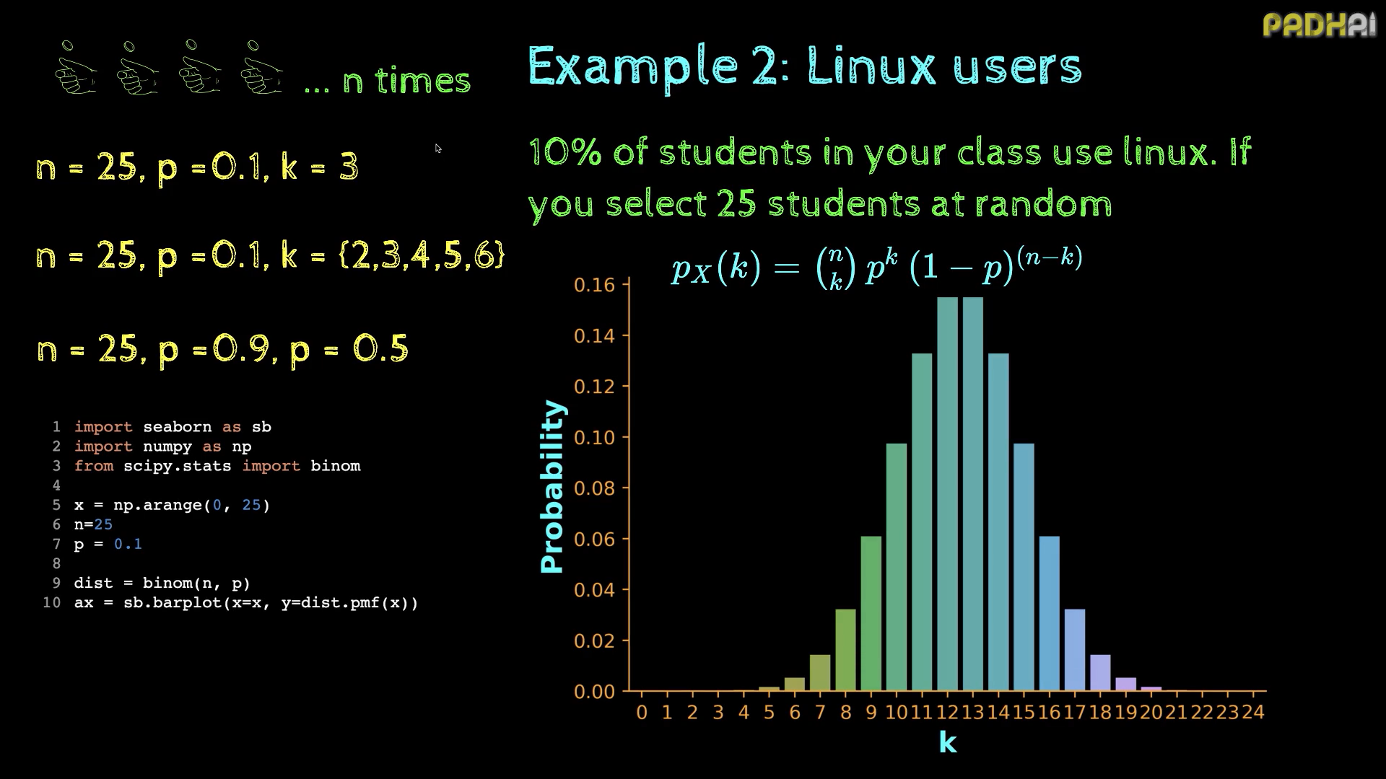

Slide 43
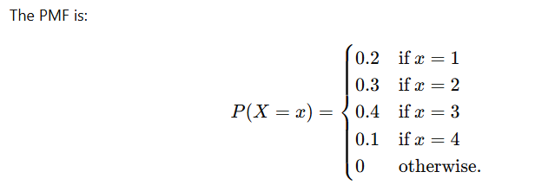

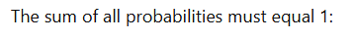
1. All the probabilities are >= 0
2. Lets check the sum of all the probabilities:

Slide 44
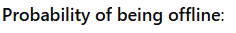

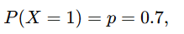
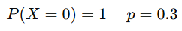
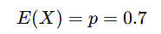
A website has a 70% chance of staying online. What is the probability that the website is offline? What is the expected value for being online?

Slide 45
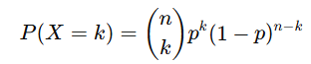

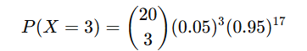
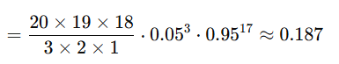




Problem 1: Online Advertisement
A company runs an online ad campaign, and the probability that a user clicks on the ad is 0.05. Out of 20 users:
What is the probability that exactly 3 users click on the ad? (Binomial distribution)
What is the probability that no one clicks on the ad? (Bernoulli for a single trial; Binomial for 20 trials)
What is the expected number of users clicking on the ad? (Use n×pn \times pn×p for Binomial)

Slide 46








Problem 2: Quality Control
A factory produces light bulbs, and 90% of them pass quality control. Out of 10 bulbs randomly selected:
Write the probability mass function (PMF) for the number of bulbs passing quality control.
Find the probability that exactly 7 bulbs pass inspection.
Find the probability that at least 8 bulbs pass inspection.
What is the expected number of bulbs that will pass?
PMF:

Slide 47







Problem 4: Stock Market Data
A stock price increases with a probability of 0.6 every day. Over a 5-day period:
What is the PMF for the number of days the stock price increases?
Find the probability that the stock price increases exactly 3 times.
What is the expected number of days the stock price increases?

Slide 48











Problem 3: Coin Tossing (Bernoulli & PMF)
A fair coin is tossed:
What is the PMF of the number of heads (X) in a single toss?
Extend the problem to 5 tosses (Binomial), and find:
Probability of getting exactly 3 heads.
Probability of getting at most 2 heads.
Expected number of heads.

Slide 49


